Slide 1
Quiz Master
Empowering Learning through Online Quizzes

Slide 2
Presented by:
Mahesh Pharande - 069
Rishita Rai - 078
Supriya Wasre - 118
Saurabh Patil - 119

Slide 3
Abstract
The Quizmaster project is a response to the rising popularity of online quizzes , knowledge-sharing activities. It aims to provide a user-friendly platform where people can easily create, manage, and take part in quizzes. In today's digital age, where information consumption is varied and fast-paced, there's a growing demand for platforms that offer engaging and interactive experiences. Quizmaster seeks to fulfill this need by offering a flexible platform that caters to both individual making quiz creation and participation seamless and enjoyable.

Slide 4
Users :
Admin
Student
Subscribed Student
Experts

Slide 5
Customers and Stakeholders
Customers
Students
Educational Institutions
Stakeholder
Admin
Educational Professionals (Experts)
Potential Collaborators

Slide 6
Student
Use cases
Sign in/out and view profile
Update account
View available quiz categories
Attempt quizzes
Access results
Give feedback
Make subscriptions

Slide 7
Expert
Use Cases
Sign in/out and view profile
Modify account
Add new quizzes
Add explanations to questions
View available quiz categories
View available quizzes

Slide 8
Admin
Use Cases
Create, delete, or modify accounts
Login
View Students
Add new quiz categories and subjects
Manage registered users

Slide 9
Subscribed Student
Use Cases
Sign in/out and view profile
Update account
View available quiz categories
Attempt Quizzes
Access results
Give feedback
Receive performance report

Slide 10
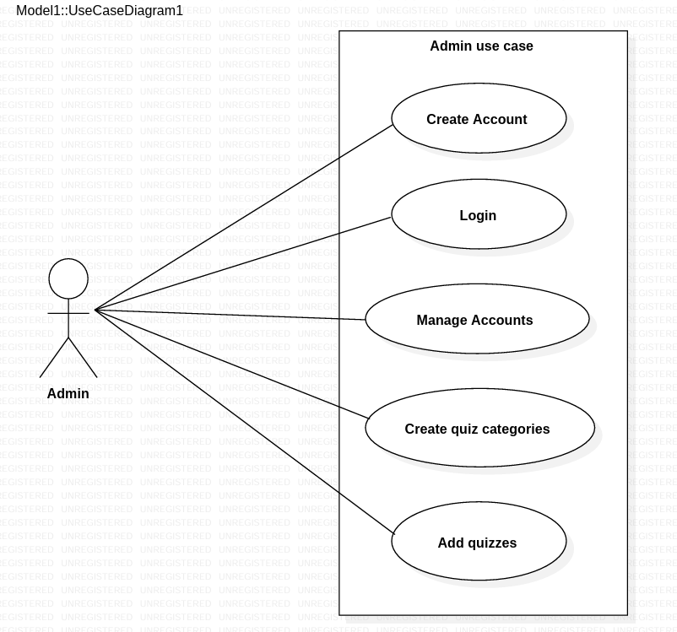
Use Case Diagram - Admin

Slide 11
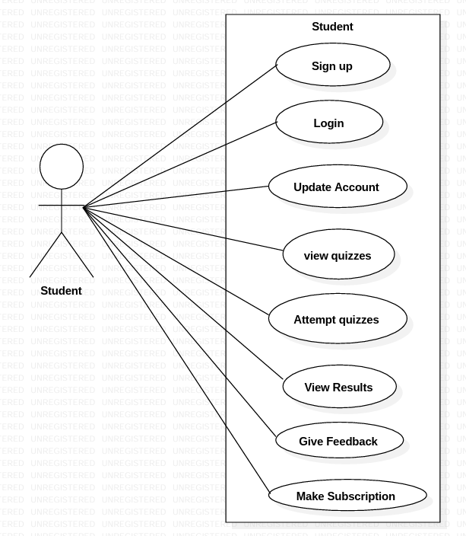
Use Case Diagram - Student

Slide 12
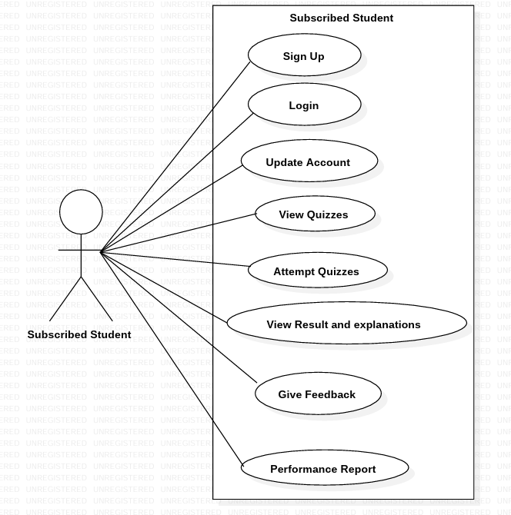
Use Case Diagram – Subscribed Student

Slide 13
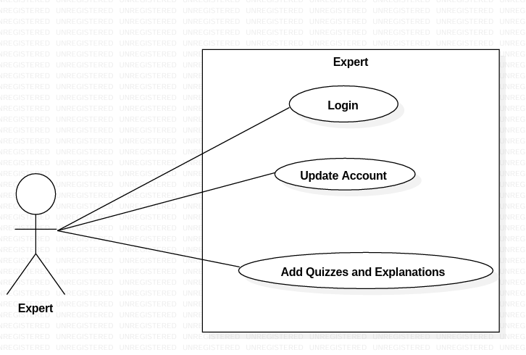
Use Case Diagram - Expert

Slide 14
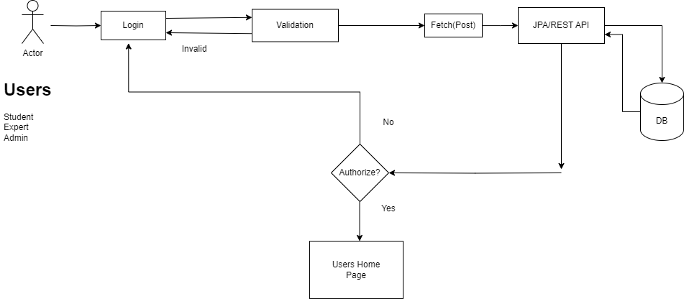
Login for Users

Slide 15
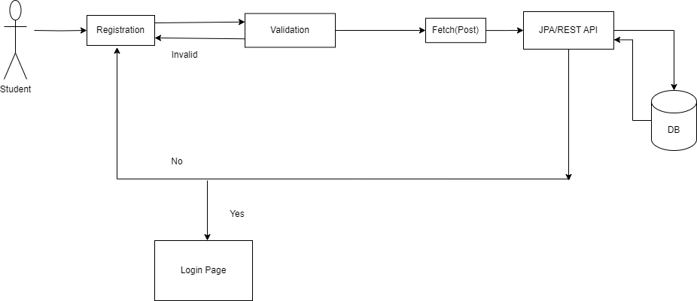
Student registration Page (Actor=Student)

Slide 16
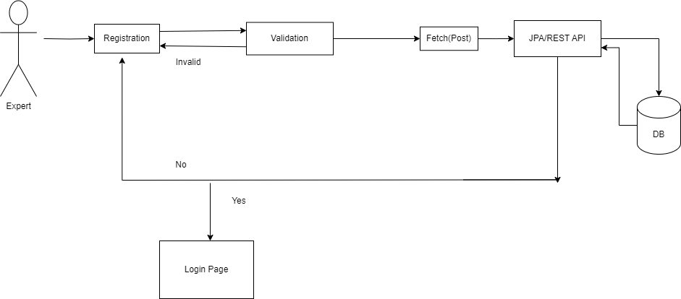
Expert Registration(Actor=Expert)

Slide 17
Validations
Basic Field Validation:
Checks if each field is empty .
If any field is empty, it sets an error message indicating that the field is required.
Contact Validation:
Ensures that the contact field is not empty.
Validates that the contact contains only digits using a regular expression (/^\d+$/).
Verifies that the length of the contact is exactly 10 digits long.
First Name Capitalization:
Checks if the first name starts with a capital letter.
If the first name does not start with a capital letter, it sets an error message.

Slide 18
Project architecture
Used for Used for Used for
User Interfacing Server Side Validation Permanent Storage
Basic Data Validation Response Handling Db level validations
Business Logic & Database op.
Technology Used Spring Boot MySQL
HTML,CSS Asp.Net Core WEBAPI
JavaScript ,React JS
FrontEnd Layer
Server Layer
Database layer

Slide 19
Html , CSS and JavaScript are used for frontend part for static Web Page.
React JS is used for rendering the dynamic web pages and to create a single page application where only particular part of web Page is rendered without altering complete web page.
Spring boot and Asp.net Core Web API is used for server side processing wherein in connection with database is established from server and required data is manipulated and sent to client side.
Ports Used
Frontend of our application is served by a web server running on local host port 3000.
Java Server was running on default port 8080.
The default port for MySQL is 3306 is used by us.

Slide 20
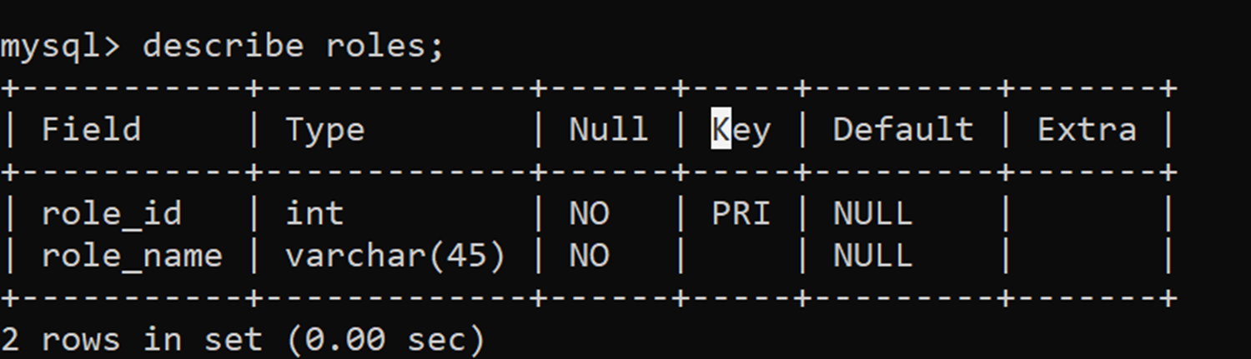
DataBase Design
Roles :We have 4 role_id in our System :
1=Admin
2=Student
3=Subscribed Student
4= Expert

Slide 21
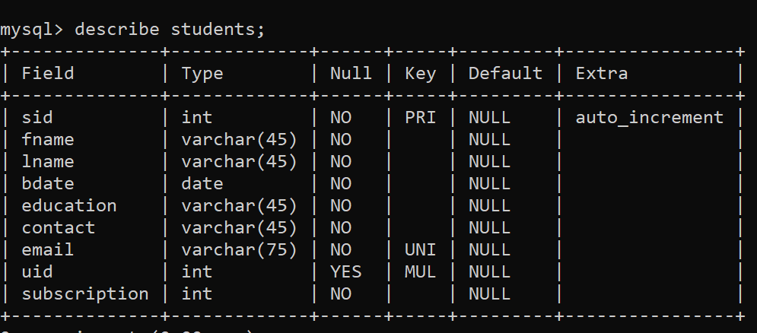

Slide 22
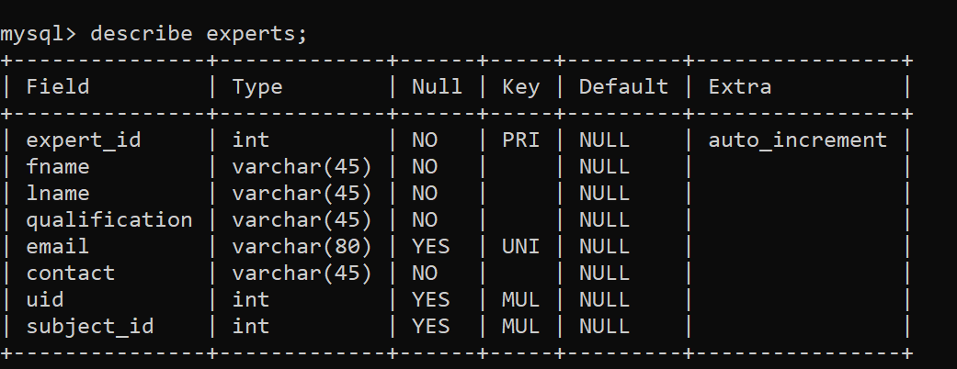

Slide 23
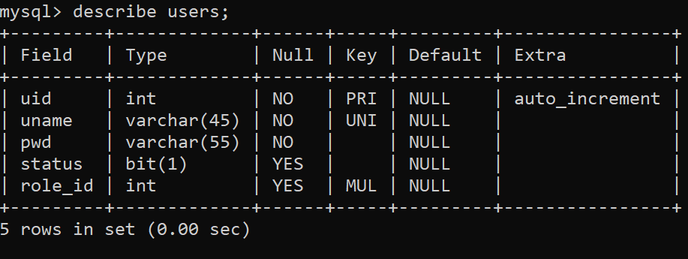
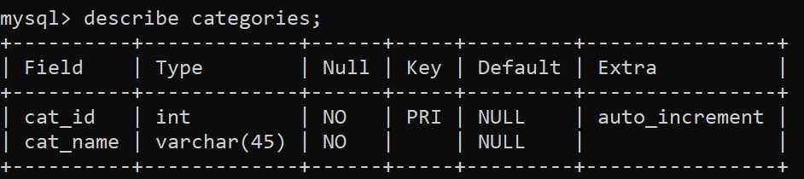

Slide 24
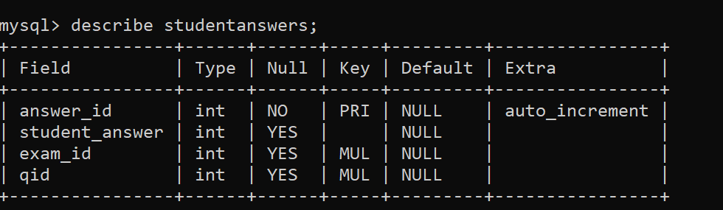
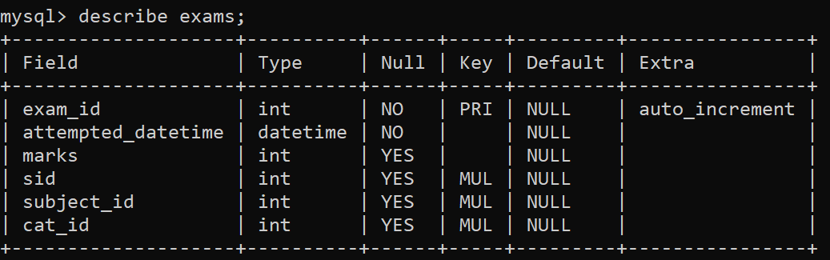

Slide 25
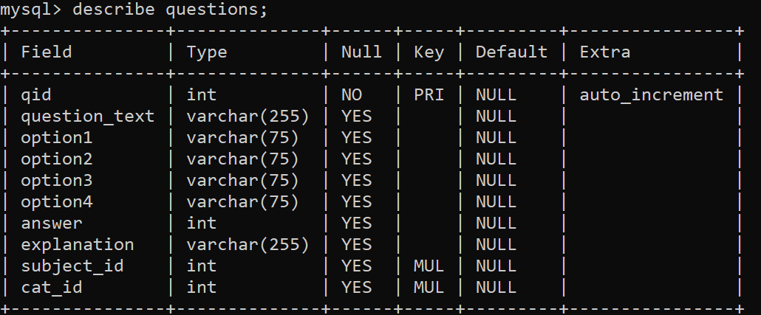
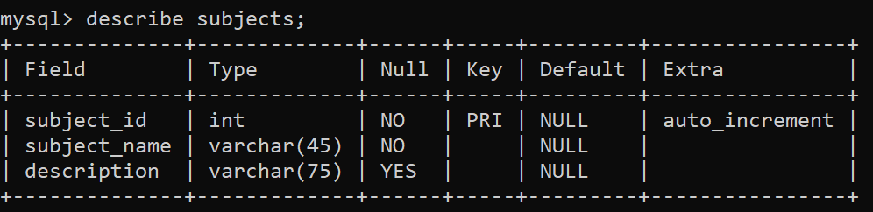

Slide 26
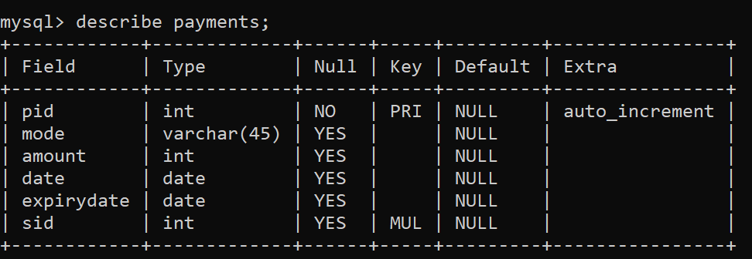
Git :
https://github.com/SupriyaW1/QuizMaster

Slide 27
Future Scopes:
Creating Study Groups:
Students can form study groups within the app. This will allow them to collaborate, share notes, and help each other prepare for quizzes.
Develop features for users to collaborate, discuss, and share knowledge within the platform through forums, chat rooms, and social networking functionalities.
Gamification and Rewards System:
Gamify the learning experience by introducing features such as badges, points, levels, and rewards for achieving milestones, completing quizzes, and participating in learning challenges.
Design engaging competitions, tournaments, and leaderboards to motivate users, foster healthy competition, and increasing active participation in the platform.

Slide 28
Adding Visual Content:
Introduce more visual content like videos, info-graphics, and animations to make quizzes more engaging and easier to understand, especially for visual learners.
Personalized Learning Paths:
We can develop a feature that recommends quizzes and study materials based on each student's learning style and performance. This way, students can focus on areas where they need improvement.
Enhancing User Feedback

Slide 29
Conclusions:
Challenges:
We encountered numerous challenges ,including determining the right path to commence our project ,Time constraint and many more.
Lessons learned:
Throughout the process we learn the valuable insights into effectively distributing tasks within the team and how to integrate diverse technologies to develop a comprehensive software solution.
Overall Experience:
Our journey was marked by practical learning experiences and wealth of knowledge ,contributing significantly to our growth and development.

Slide 30
Thank You

